Slide 1
Memory-Making in Fetal Loss: Supporting Compassionate Bereavement Care
Clinical Education Session for Labour & Delivery Nurses
Lee Dollery RN

Slide 2

Learning
Objectives
By the end of this session, participants will be able to:
Explain the role of memory-making in fetal loss care
Identify types of mementos offered to families
Demonstrate ways to introduce memory-making options sensitively
Reflect on the nurse’s role in compassionate bereavement care

Slide 3
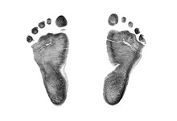
What Are Mementos?
Memory-making mementos are tangible items created to acknowledge the baby’s life and support families in their grieving process

Slide 4

Emotional & Psychological Benefits of Memory Making
Memory-making can help families:
Process grief and acknowledge their baby
Create tangible memories that support healing
Strengthen emotional connection to the baby
Validate the baby's life and the family's loss
Provide comfort and remembrance over time

Slide 5

Challenges in Supporting Memory-Making
Families and healthcare providers may face challenges such as:
Emotional difficulty for nurses and families
Limited understanding of memory–making practices
Pressure from others to “move on”
Cultural stigma surrounding pregnancy loss
Fear of judgement from others
Misconceptions about the purpose of mementos

Slide 6
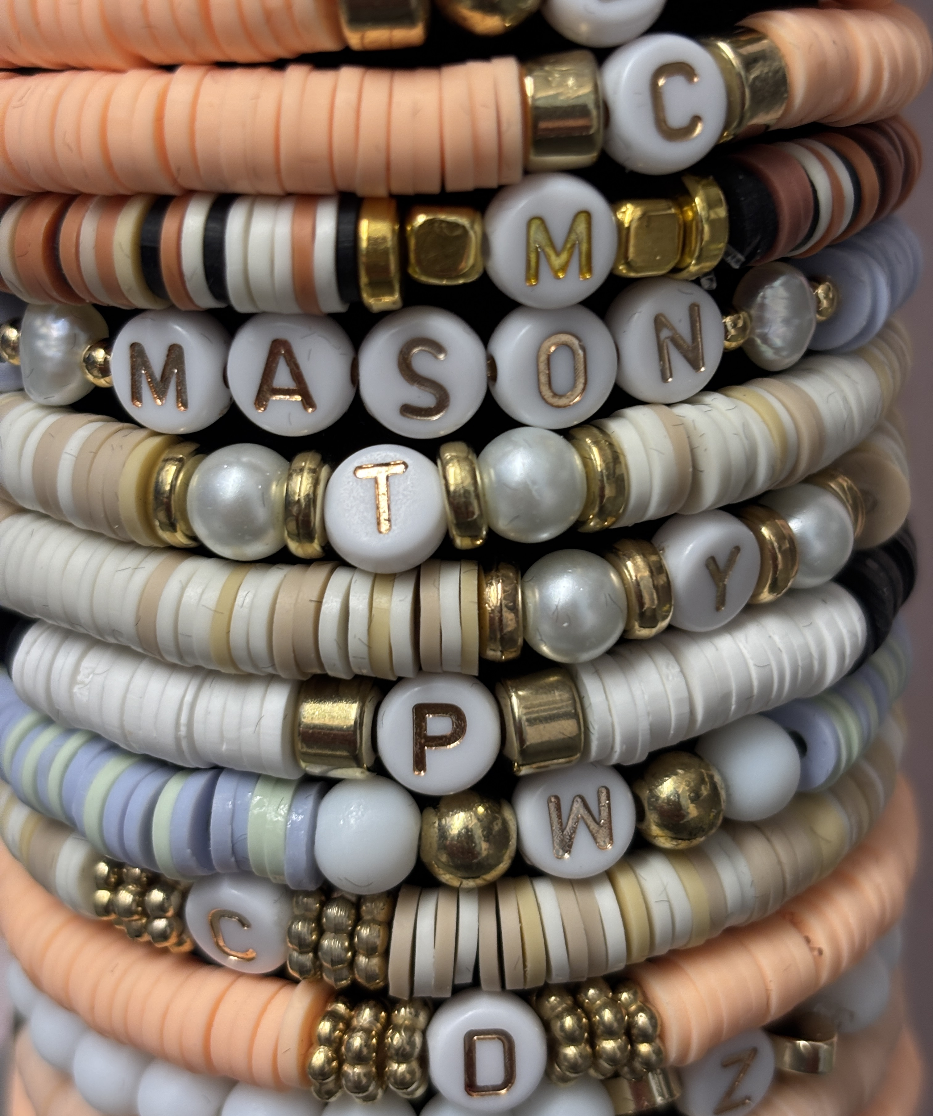
Types of Fetal Loss Mementos
Common mementos offered to families include:
Photographs - Capturing early memories
Handprints, Footprints, and foot moulds – Tangible Reminders
Hospital Bracelets & Locks of Hair – Personal Keepsakes
Memory Boxes & Personalized Items – Blankets, jewelry, stuffed animals

Slide 7

Role of Healthcare Providers
Nurses play an important role in supporting memory-making by:
Introducing memory-making options with sensitivity
Providing clear explanations of available mementos
Respecting family choices and cultural preferences
Obtaining consent before creating keepsakes
Supporting families emotionally throughout the process

Slide 8
Ways to Introduce Memory-Making
Helpful approaches include:
Offering memory-making options gently and without pressure
Using clear and compassionate language
Allowing families time to consider their choices
Reassuring families that accepting or declining mementos is ok
Supporting families regardless of their decision

Slide 9

Reflective Discussion
What challenges have you experienced when supporting families during fetal loss, and how might memory-making support compassionate care?

Slide 10
Key Takeaways
Memory-making helps acknowledge the baby’s life
Mementos can support healing and remembrance
Nurses play a critical role in introducing these options
Compassionate communication supports family-centred care

Slide 11
References
Davis, Deborah L., 1955- author. Title: Empty cradle, broken heart: surviving the death of your baby / Deborah L. Davis, Ph.D. Fulcrum Publishing 7333 W. Jefferson Ave., Suite 225 Lakewood, CO 80235
Rachel M. Lewis, author. Title: Unexpecting real talk on pregnancy loss/ Rachael M. Lewis. Published by Bethany House Publishers 11400 Hampshire Avenue South Bloomington, Minnesota 55438 www.bethanyhouse.com
Heather Dolson RN, author. Title: Whole Navigating the Trauma of Pregnancy Loss Heather Dolson, R.N. Heather on Health Copyright © 2022 by Heather Dolson and Heather on Health.
Jane Heustis, RN. & Marcia Jenkins RN. Foreword by Alan D. Wolfelt. Ph.D. Title: Companioning at a Time of Perinatal Loss - A Guide for Nurses, Physicians, Social Workers, Chaplains, and Other Bedside Caregivers. Companion Press The Center for Loss and Life Transition 3735 Broken Bow Road Fort Collins, CO 80526 (970) 226-6050 www.centerforloss.com
Ingrid Kohn, MSW, and Perry-Lynn Moffitt, with Isabelle A. Wilkins, MD. Title: A Silent Sorrow. Pregnancy Loss: Guidance and Support for You and Your Family. Published in 2000 by Routledge, 711 Third Avenue, 8th Floor, New York, NY 10017, United States
Image(s) and/or video used under license from Shutterstock.com

